Slide 1
Social Justice Advocacy
Gwen Chodur, MSPH RDN
Director of Social Justice Concerns & Advocacy Chair, NAGPS
External Vice-President, UC Davis GSA

Slide 2
Social Justice Issues Impacting Graduate Students
Gender Discrimination
Basic Needs Insecurities
Student Debt
Mental Health

Slide 3
Gender Discrimination
As many as 50% of graduate students in science, engineering, and medicine have experienced sexual harassment*
Racial and sexual minorities are most vulnerable
NASEM and professional societies have begun to frame gender discrimination in terms of research integrity and professional ethics
Updates to Title IX proposed rule change: More than 100,000 comments received – it took more than a year to read and respond to them all
Office of Budget and Management then undertook review, which was completed 3/27. Expect rules to be published sometime in the near future

Slide 4
Basic Needs Insecurities
Students at both the undergraduate and graduate level experience food insecurity at higher rates than the general population*
Significant barriers to qualification for means-tested programs such as SNAP: not all titles held by grad students count towards the work requirement, determination of taxable income is needlessly complicated, 9 month appointments can cause problems, not all populations are eligible
There are negative health, psychological, behavioral, and academic outcomes associated with basic needs insecurities.

Slide 5
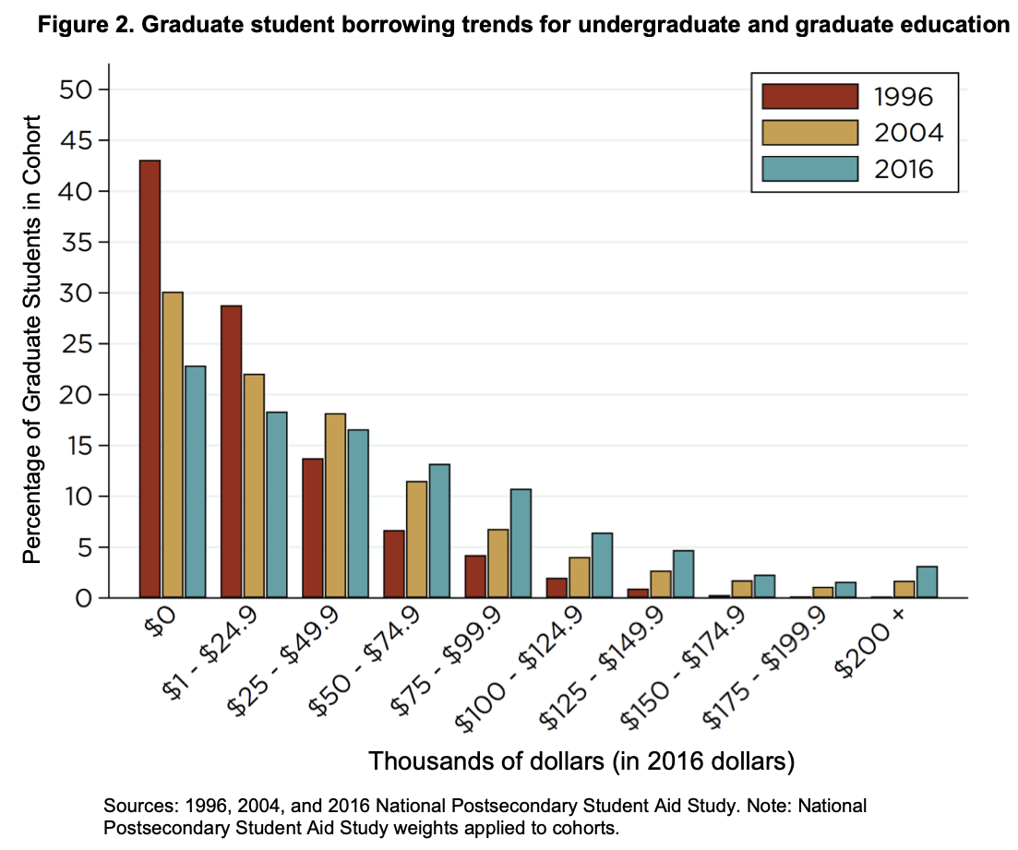
Student Debt
Graduate students in total hold 40% of the cumulative national student loan debt - $604 billion in total, averaging out to $57,600/grad student.*
Debt burden falls disproportionately on women, first-gen students, students of color and students with LGBTQIA+ identities - ie, students who are also less likely to be basic needs secure during their study
Trump’s budget for FY2021 proposes to sunset the Public Service Loan Forgiveness Program
As of February 2020, less than 2% of applicants for the PSLF program were approved*
Current global situation highlights need for trained epidemiologists

Slide 6
Mental Health
39% of graduate and professional students report experiencing symptoms of moderate to severe anxiety and depression (6x the rate of the general population)*
Super-majority of university presidents (81%) consider mental health a priority, but only 30% feel their campus has the needed tools to address the issue*

Slide 7
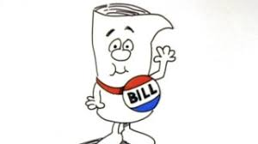
When & Where Can We Advocate?
Within the Legislative Process
As a bill is being drafted
Throughout the legislative process
Within the Budget Process
Budget proposals and reconciliations
Budget revisions
Within the Rules-Making Process
Federal agencies are required to seek public comment before implementing rules changes

Slide 8
What are rules changes?
Congressional legislation provides the “what” to do; federal agencies interpret this legislation to provide guidance on “how” to do something
Rules change for many reasons:
Presidential directives
Recommendations from federal advisory committees or Congressional committees
Requests from other agencies
Recommendations from agency staff

Slide 9
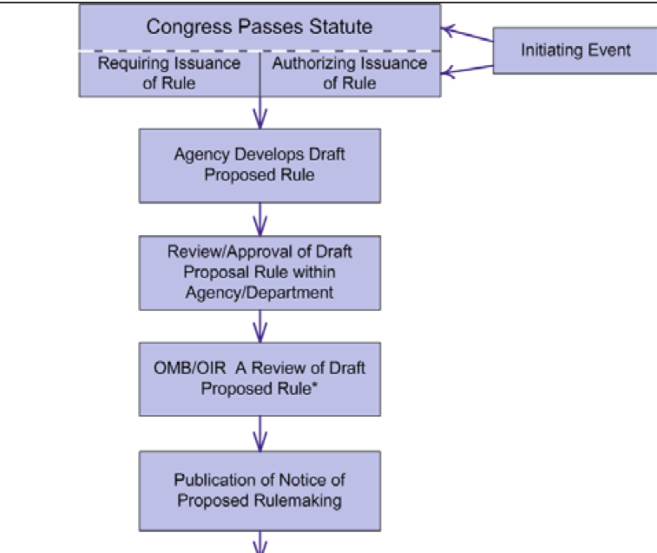
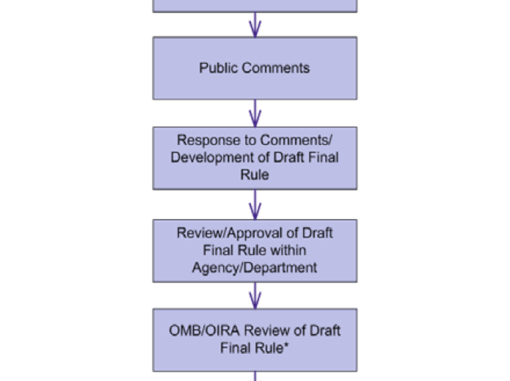
Public comment period can be an important avenue for advocacy efforts – agencies are required to respond to “substantively different” comments

Slide 10
How to write effective public comment
Understand and clearly identify what aspects of the proposed policy you are commenting on – include citation from the Federal Register with page number at a minimum
Comments do not need to address every issue
Most effective comments employ sound science and reasoning – support your position with quantitative or qualitative data if possible
Not all comments are weighted equally – form letters are not effective.
Identify credentials and use citations!
Suggest alternatives to positions with which you disagree
Discuss the pros and cons of your position and address them

Slide 11
Technical Aspects to Public Comment
Comment period closes at 11:59 Eastern, so you should plan to submit comments well in advance
Keep a copy of your comments in a separate word file
It is recommended to use a specific naming convention for file attachments (and you should refer to them in this way within your comment)
Attachment1_ <File name>
Attachment2_ <File name>

Slide 12
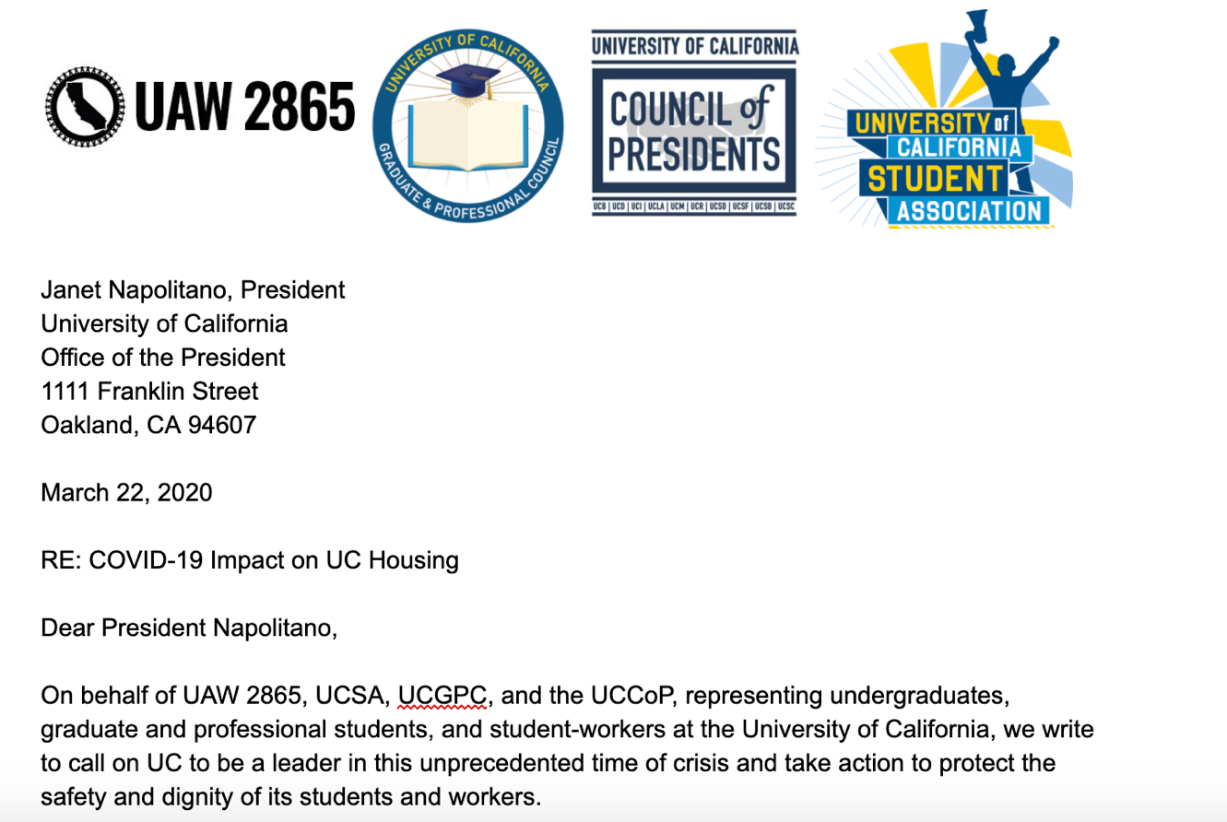
Social Justice Advocacy on Campus
Identify an issue
Build coalitions
Think about possible solutions
Build an ask
Make sure your ask is:
Actionable
Realistic
Addressing the issue
Delivered to the right people

Slide 13
Successes of Student Advocacy

Slide 14
Advocacy and Leadership in the Midst of a Crisis
COVID-19 crisis has demonstrated the precarity of graduate and professional students
Strongly encourage you all to step up: reach out to your admin and representatives to make sure that we are part of the conversation
Think about immediate needs, but also medium to long term needs that may arise among students on your campus

Slide 15
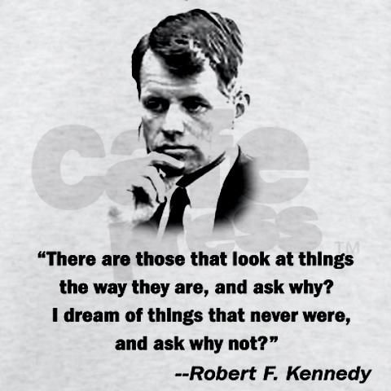

Slide 16
Thank you!
dsjc@nagps.org
gmchodur@ucdavis.edu

