Slide 1
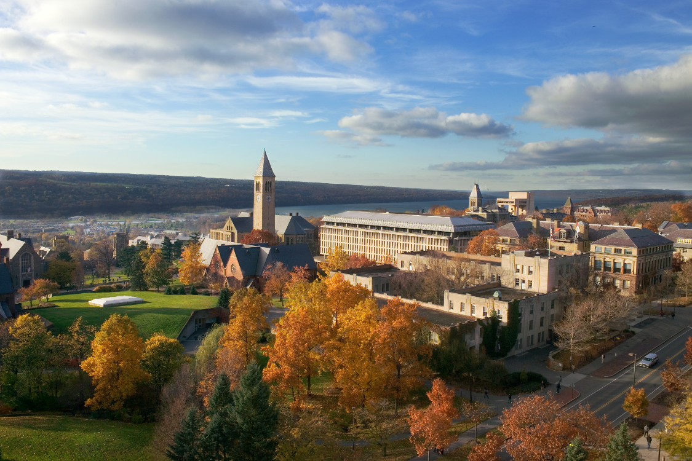
Graduate & Professional
Student Assembly
Strategic Planning for
Graduate Student Organizations:
Advocacy and Institutional Memory
Nicole M. Baran
Counsel to the Assembly
(former Executive Vice President)
Graduate & Professional Student Assembly Cornell University

Slide 2
Graduate & Professional
Student Assembly
Graduate & Professional Student Assembly (GPSA) Overview
7,000 graduate & professional students
GPSA is one of four assemblies
19 voting members, plus ~100 “field reps”
Activity Fee: $81/student/year
What GPSA does:
Set & allocate the activity fee
Advocate for 7,000 graduate/professional students
Graduate school: 5,174
Professional schools: 1,809

Slide 3
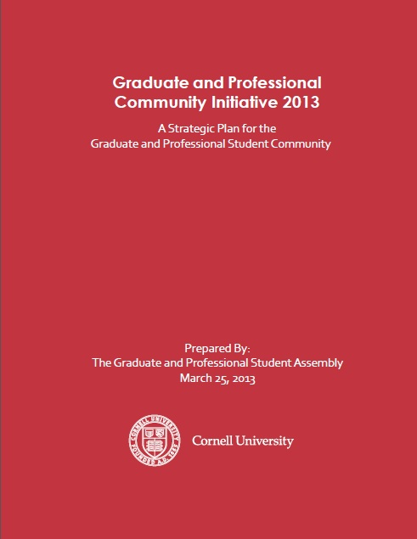
Graduate & Professional
Student Assembly
The Document
http://www.cornellgpsa.com/
wp/grad-community-initiative/

Slide 4
Graduate & Professional
Student Assembly
Graduate Community Initiative 2007
“The [GCI] is a vision presented to our University by the GPSA to address critical issues in graduate student life at Cornell. We propose that it is time for Cornell University to actively and meaningfully discuss what kind of graduate student community we would like to foster on campus.
Employing an integrated and proactive approach, the Initiative brings interconnected elements together in conversation, moving away form reacting to individual problems and towards proposing innovative, global solutions.”

Slide 5
Graduate & Professional
Student Assembly
The Process
Collaborative
Comprehensive
Strategic

Slide 6
Graduate & Professional
Student Assembly
Strategic Planning for GSAs
Think about your own GSA
Strengths Weaknesses Opportunities Threats
Do you need a strategic plan?
Do you have the resources?
What is your vision for graduate students at your university?
What are some major issues/problems/concerns?
Would your administration value a strategic plan?

Slide 7
Graduate & Professional
Student Assembly
Tasks & Timeline
Evaluation of 2007 GCI
“State of the Community” reports
Town halls, student input
Meet with administrators
SWOT Session
Draft topic area reports
Vote/formalize document
Present to Cornell Board of Trustees
Create “Implementation Plan”
Sept-Oct
Oct
Nov-Feb
Nov-Feb
Feb
Feb-March
March 25
March 28
April-May

Slide 8
Graduate & Professional
Student Assembly
Topic Areas
Graduate & Professional Student Center
Career Resources
Mental Health & Well-being
Diversity & International Students
Family Services
Housing
Transportation
Sense of Community

Slide 9
Graduate & Professional
Student Assembly
Objective: Support graduate students who choose to pursue non-academic careers
Rationale: For the last several decades, the supply of tenure-track positions has not kept pace with the number of doctorate holders produced by universities—this is especially the case in the social sciences and the humanities. This disconnect does not result solely from macroeconomic factors, having persisted through periods of both economic expansion and contraction. Cornell must therefore prepare its students not only for traditional academic positions, but also alternative positions within the academy (“alt-ac”) and non-academic positions….
Actions
Encourage all faculty to support students who choose to pursue non-academic careers. A first step could be to provide Directors of Graduate Studies with more material and information concerning careers not traditionally pursued by students in their field.
Increase opportunities for networking with alumni, especially those who have successfully pursued non-traditional career paths (see also Objective 4).

Slide 10
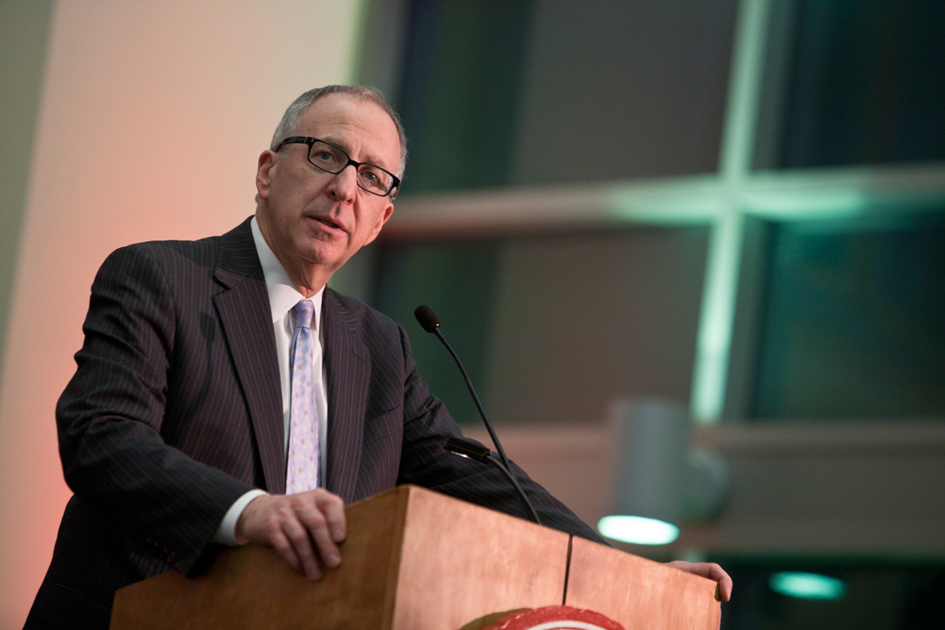
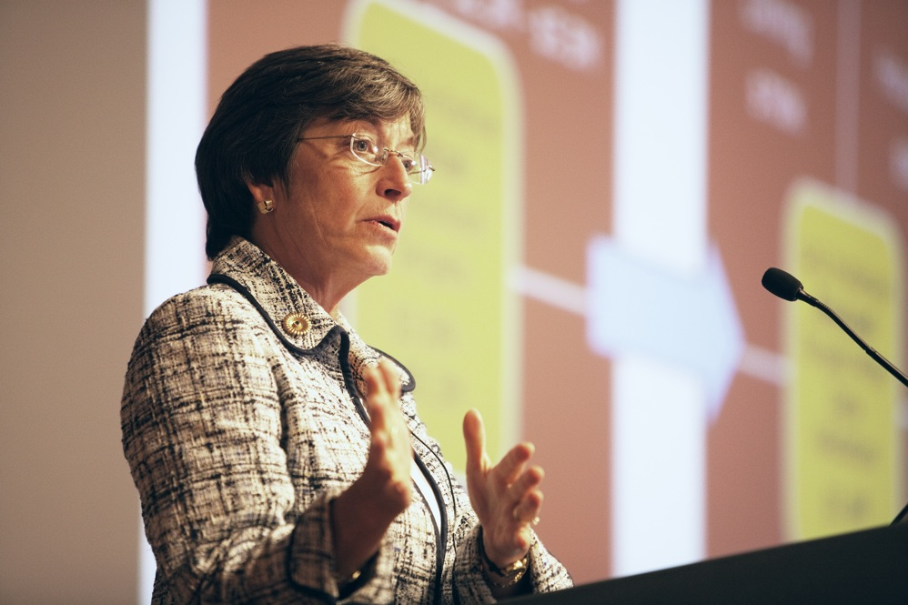
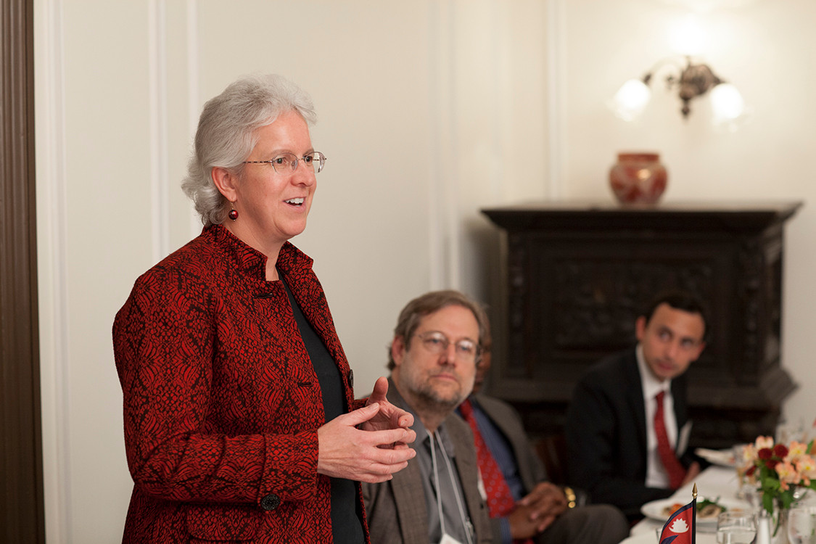
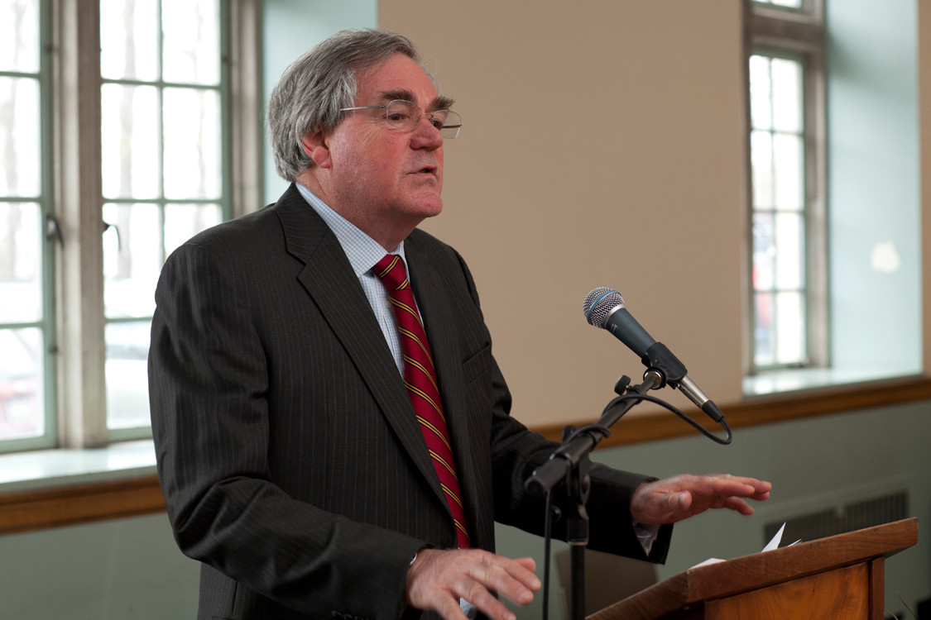
Graduate & Professional
Student Assembly
Administration Response
VP for Student & Academic Services
Susan Murphy
Cornell President
David Skorton
Dean of the
Graduate School
Barbara Knuth
Dean of Students
Kent Hubbell

Slide 11
Graduate & Professional
Student Assembly
Administration Response
Creation of the GPCI Working Group
Led by the Dean of the Graduate School and VP for Student & Academic Services
Composition:
Representatives from the Graduate School
Deans of three Professional Schools (Business, Law, Vet) and the Dean of Students
Members of the GPSA Executive Board and several GPSA Committee Chairs
Currently identifying which administrators/staff should be primarily responsible for each section

Slide 12
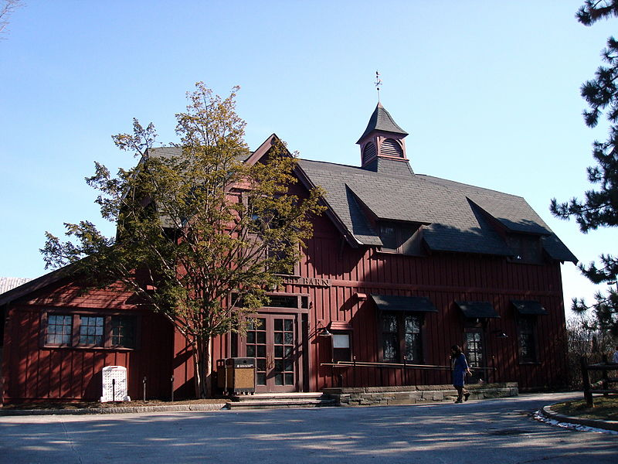
Graduate & Professional
Student Assembly
Administration Response
GPSA presented to the Council on Mental Health & Welfare
Comments about the Graduate &
Professional Student Center have
been discussed as a step after
current Big Red Barn renovations
Career Services staff have already
been incorporating suggestions into
the creation of new programming and events
In meetings, administrators often have their copy of the GPCI and refer to specific chapters & recommendations

Slide 13
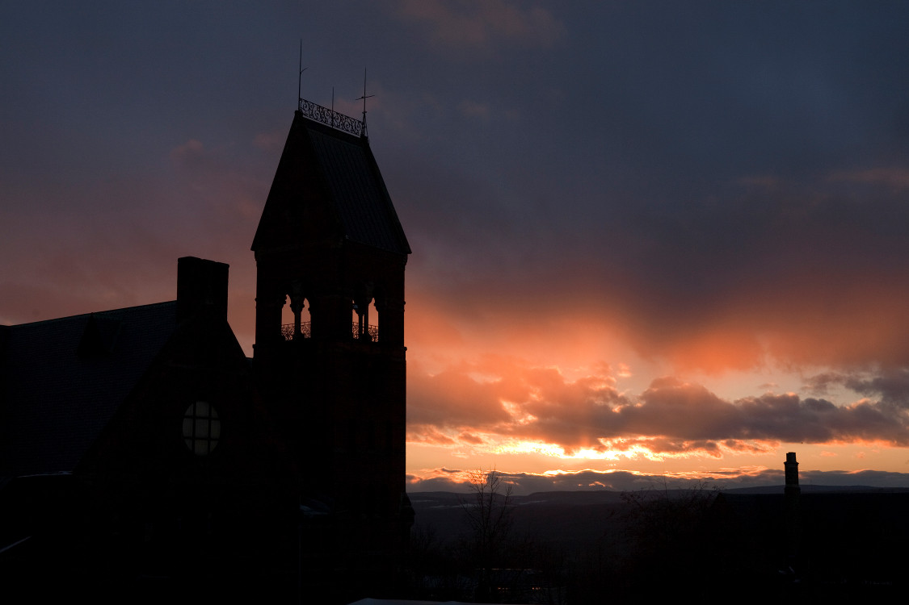
Graduate & Professional
Student Assembly
Questions?
Email: nmb68@cornell.edu
gpsa@cornell.edu
Phone: 720-371-4149

